Slide 1
Validation of Circular RNA (hsa_circ_0012107) Expression Profile as an Efficient Diagnostic Biomarker for Diabetic Retinopathy
Research Team members:
Dr.Doaa Hussein Hassan Dewedar
Ahmed Mohamed abd alhamed
Mahamed Adel Mohamed
Magdy Ahmed Mahmoud
Mentor
Assistant Professor Dr: Rania Serag

Slide 2
Background
The prevalence of diabetes mellitus (DM), which is a significant global health concern, is predicted to rise to an alarming 8.8% of the adult population by 2025. The percentage of adults worldwide who have diabetes is predicted to rise to 10.4% in 2040, totalling 642 million diabetic patients ( Ogurtsova et al.,2017) . Ninety percent of all diabetes cases are Type II. (DeFronzo et al.,2010).
Microvascular complications associated with type 2 DM are becoming much more common. Chronic hyperglycemia damages the microvasculature, which eventually results in diabetic nephropathy, retinopathy, and neuropathy, which have a significant negative impact on quality of life and overall life expectancy. ( Faselis Khan et al.,2020) .
One of the leading causes of vision loss in young ages is diabetic retinopathy (DR) (Antonetti et al., 2021)
Over 50% of people with diabetes, primarily type II DM, pass undiagnosed (International Diabetes Federation;2019)

Slide 3
Significant functions of circular RNA (circRNA)
Gene Regulation
Protein Production
MicroRNA Sponge
Cellular Signaling
Interaction with RNA-Binding Proteins

Slide 4
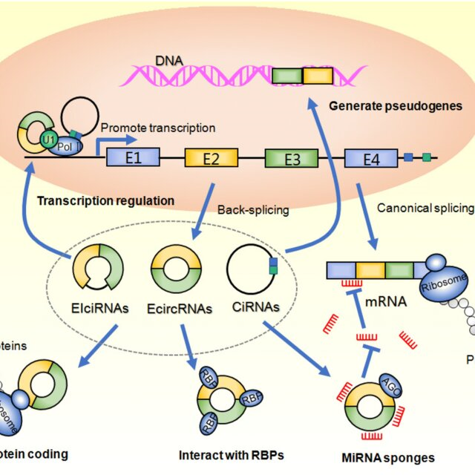
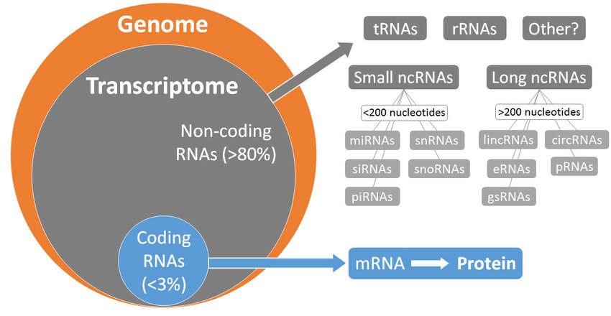
Relation between Circular RNA (circRNA), messenger RNA (mRNA), and microRNA (miRNA) and sirna

Slide 5
Is circular RNA (circRNA), used in clinical or preclinical stage?
To assess the potential diagnostic capabilities of the circular RNAs, a systematic review was conducted, with a particular emphasis on preclinical studies ( Lu et al. in 2021 ) and a clinical trial to measure its diagnostic performance (He et al. 2022).
circular RNA-based therapy could become a reliable tool in diabetes management based on preclinical and clinical data (Zaiou et al ;2020).
circular RNA could potentially be used as a diagnostic tool in clinical settings which is importance for early diagnosis of diabetic retinopathy in primary care(Jimenez-Baez et al ;2015)
Therefore, they appears that circular RNA has been studied in both preclinical and clinical settings for its potential diagnostic and therapeutic value in diabetic retinopathy.

Slide 6
At which stage of diabetes circular RNA (circRNA) used ?
It is commonly used for early diagnosis in mild non proliferative diabetic retinopathy (NPDR). Mild NPDR is the earliest stage of diabetic retinopathy and is characterized by the presence of at least one micro aneurysm. At this stage, patients are generally asymptomatic, and vision is not affected. However, it is important to detect mild NPDR early to prevent the progression of the disease to more advanced stages, which can cause severe vision loss.

Slide 7
State of Art
In the field of circRNA research, the focus on retinal development and disease has revealed important insights. CircRNAs are abundant in the retina, crucial for its development, and associated with various retinal diseases, including diabetic retinopathy. They also show promise as early disease markers in retinal degeneration. While the broader biological roles of circRNAs remain under investigation, these findings represent the state of the art in circRNA research within the context of retinal biology and pathology, holding potential for diagnostic and therapeutic applications.

Slide 8
Aim of the study
Investigate Circular RNA (hsa_circ_0012107) to ascertain its potential as a diagnostic biomarker for diabetic retinopathy and simultaneously explore its expression patterns, related pathways, and functions to gain comprehensive insights into its role in the disease's pathogenesis and clinical applicability.

Slide 9
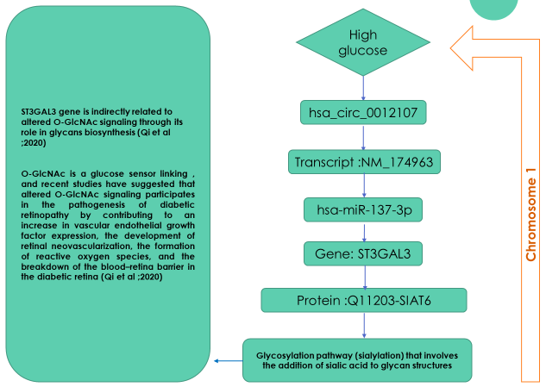
hypothesis

Slide 10
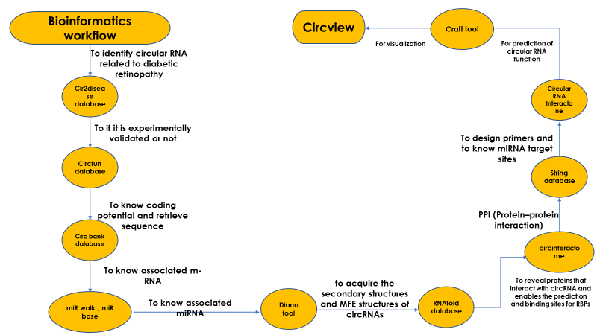
Methodology

Slide 11
Bioinformatics analysis
The parent genes of differential circRNAs were analyzed using KEGG and GO analyses to predict their biological functions.
Enriched biological modules and signaling pathways were analyzed by Gene Ontology Enrichment and Kyoto Encyclopedia of Genes and Genomes analysis, respectively.
Circular RNA microarray analysis was performed to screen differential circRNAs in DR patients compared to healthy controls and DM patients.
Real-time quantitative reverse transcription PCR (RT-qPCR) was performed to validate differentiated levels of several circRNAs in different groups of healthy control subjects, DM patients, and DR patients.
The diagnostic performance of candidate circRNAs was measured by operating characteristic curves (ROCs).
Statistical Analysis
Statistical analysis will be performed by SPSS for Windows software. The obtained results will be correlated with the different clinicopathological factors of the patients. The significant
difference of RT-qPCR results will be analyzed by using independent t test. For the comparison of each group, p < 0.05 will be considered statistically significant.

Slide 12
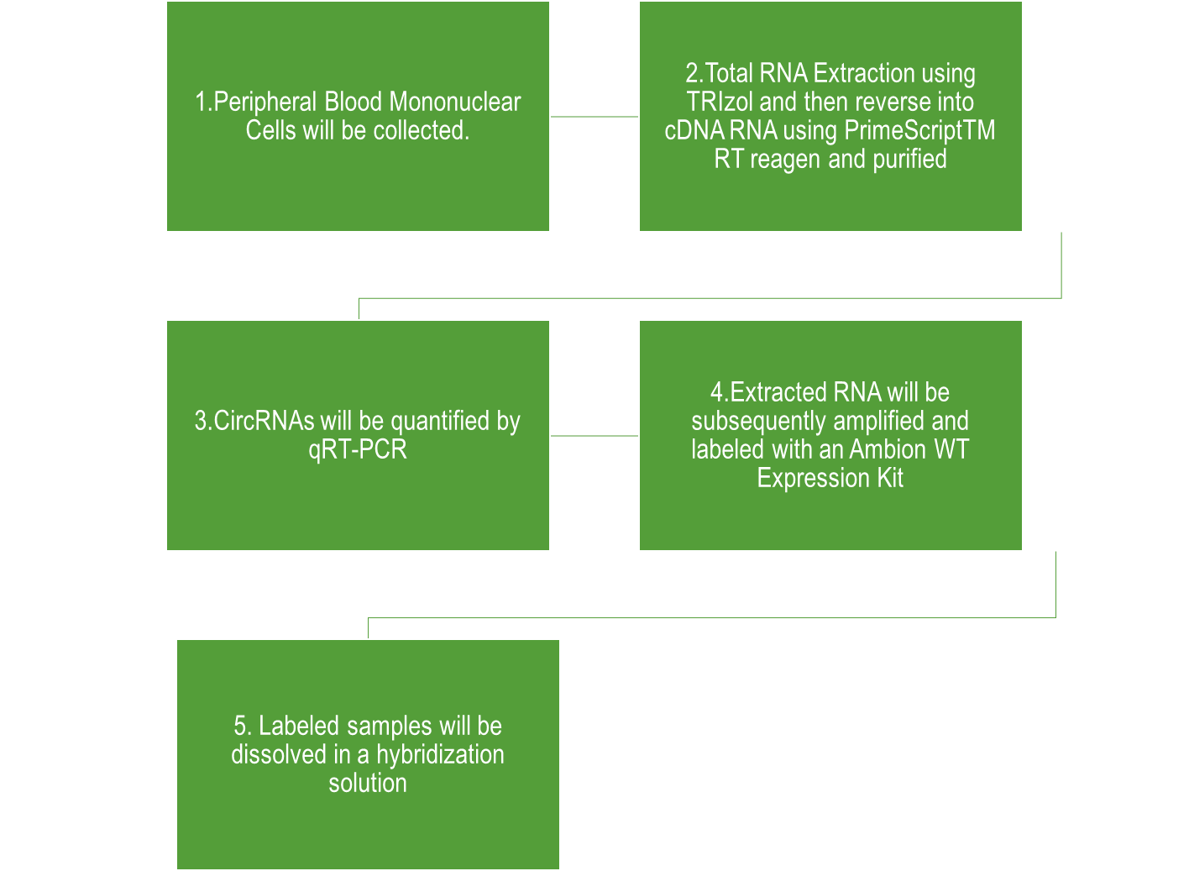
Plan for execusion of the study:
Type of study: Pilot study.
Validation steps
patient groups
Inclusion criteria
Age of > 18 years .
Mental and physical ability .
Proved diagnosis of Diabetes according to AASLD .
Exclusion criteria
Patients with other chronic diseases
Type II DM patients suffering from complications other than DR
1-healthy controls. 2-diabetes mellitus (DM) patients. 3- and diabetic retinopathy (DR) patients.

Slide 13

Plan for execusion of the study:
The following parameters will be documented from the records of the patients:
Full personal history and thorough clinical examination.
Laboratory investigations for type II DM using one of the following methods:
HbA1c
Fasting blood glucose
Oral glucose tolerance test
Random blood glucose
Complete blood picture
Posterior segment examination (retinal assessment)
Optical Coherence Tomography Angiography (OCTA)

Slide 14
Plan for execution of the study:
Requirements
Anticoagulation tubes
TRIzol reagent
PrimeScriptTM RT reagen
MiRNA Isolation Kit
qRT-PCR
Ambion WT Expression Kit
Hybridization solution
Capital Bio Technology Human CircRNA Array v2 microarray (Agilent)
OCT
OCTA
fundus fluorescein Angiography.

Slide 15
Month 1-2: Practical Work and Data Collection
Begin practical work: Collect clinical data and blood samples from diabetic retinopathy patients and control subjects.
Isolate RNA, including hsa_circ_0012107, from collected samples.
Conduct preliminary analysis of hsa_circ_0012107 expression patterns.
Month 3-4: Laboratory Analysis and Validation
Perform quantitative PCR (qPCR) experiments to measure hsa_circ_0012107 expression levels.
Validate qPCR results using statistical methods.
Collaborate with bioinformaticians for data analysis.
Month 5-6: Bioinformatics Analysis
Utilize bioinformatics tools and techniques to identify pathways and functions associated with hsa_circ_0012107.
Analyze the integrated dataset that combines experimental and bioinformatics data.
Investigate expression patterns specific to diabetic retinopathy and related pathways/functions.
Month 7-8: Data Interpretation and Manuscript Preparation
Interpret the integrated data to draw conclusions about hsa_circ_0012107's role in diabetic retinopathy.
Begin drafting the research paper, incorporating findings from both experimental and bioinformatics analyses.
Review and edit the manuscript for clarity and accuracy.
Month 9-10: Review and Finalization
Seek feedback from mentors, collaborators, and bioinformaticians to refine the manuscript.
Finalize the research paper, ensuring all aspects of the study are thoroughly addressed.
Month 11-12: Publication and Dissemination
Submit the research paper to relevant journals for peer review.
Prepare for potential revisions and respond to reviewers' comments.
Aim for publication and dissemination of research findings.
Present the results at conferences or symposiums to reach a wider audience.
EXPECTED TIME TABLE

Slide 16
Expected outcome
Identify and validate the potential rule of hsa_circ_0012107 in early diagnosis of diabetic retinopathy
Evaluate the diagnostic accuracy of hsa_circ_0012107 as a biomarker for early detection of diabetic retinopathy, with the aim of establishing its clinical utility in identifying the condition at its initial stages.

Slide 17


